Slide 1



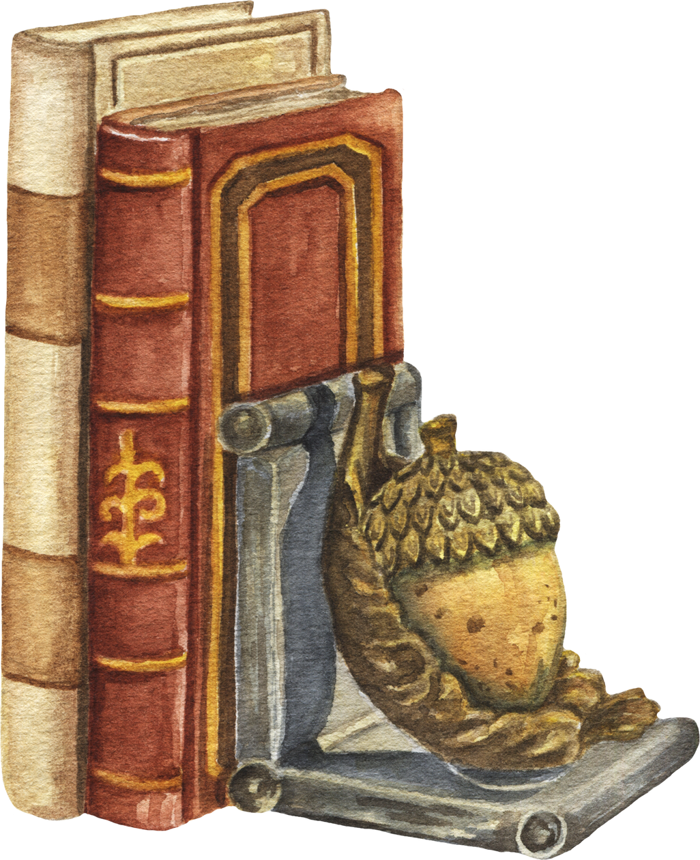


Semantic Book Recommendation System Using Word Embeddings

Slide 2
Why Recommending Books is Hard?
Traditional systems rely on ratings or tags
But similar themes aren’t always
Can we capture semantic similarity using descriptions?
obvious from metadata

Slide 3
Objective
The Goal of This Project is to build a system that:
Understands book meaning through descriptions
Uses GloVe embeddings
Recommends similar books in a human-like way

Slide 4
How It Works
Process:
Clean description text
Convert each book into an average embedding vector
Use cosine similarity to find closest books
Return top-N similar titles

Slide 5

Example Output
Harry Potter and the Sorcerer's Stone
x
The Magicians and Mrs. Quent
James Potter and the Hall of Elders' Crossing
Dead Beautiful
#Recommended based on description similarity using GloVe embeddings

Slide 6
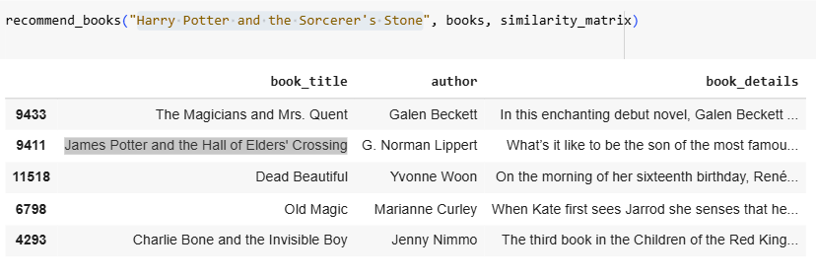
How the Recommendation System Works”

Slide 7
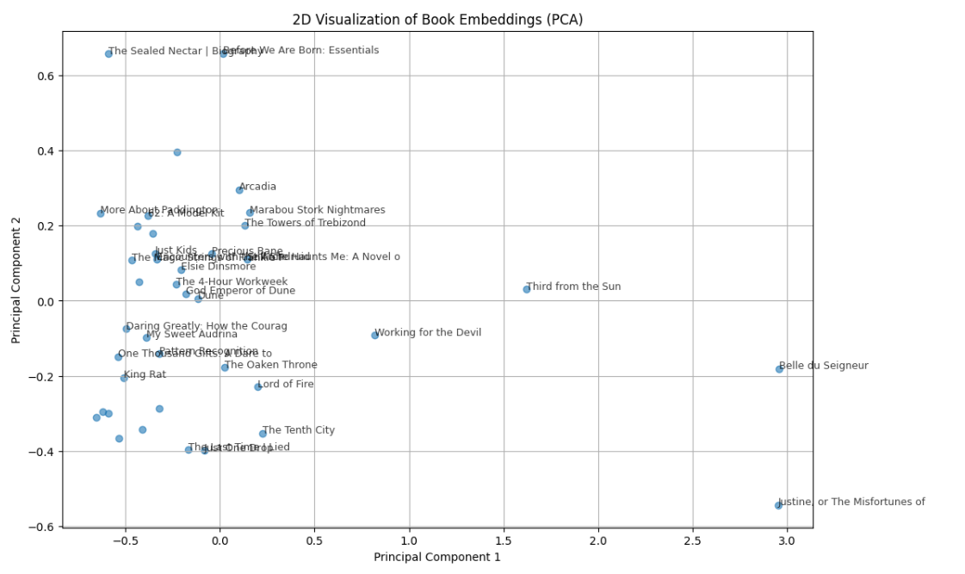
Exploring Embeddings Visually

Slide 8
Check the whole project
Curious how this works under the hood?
Dive into the full implementation, code, and detailed walkthrough on my GitHub!
link

Slide 9
Thank You

